Slide 1
PM2.5 prediction
- Pranav Nambiar

Slide 2
Details
Github: https://github.com/PranavNambiar123/PM2.5-Prediction-Project-IIT-Kanpur
Roll number: 233562458
IITK email: nambiarpv23@iitk.ac.in

Slide 3
Previously
We cleaned data using different cleaning methods: linear interpolation, spatial average or mean, median methods
Passed this cleaned data through a linear regression
Compared it against gradient boosting implementation
Saw that gradient boosting quickly started getting out of hand with size due to decision trees
This slide we test LSTM and compare against LSTM

Slide 4
LSTM
XGBoost is a good algorithm for PM2.5 prediction generally
As we have interactions between different factors
Also xgboost internally handles null or Nan data points
Also includes L1 and L2 regularisation
The downside is that it is very memory intensive, as it creates an ensemble of decision trees the memory requires to store the model increases linearly with the number of trees.
We used number of trees = 200 and max depth = 8 for our training

Slide 5
Issue faced and optimisations
Here are the key optimizations made to reduce memory usage and improve performance:
Model Architecture:
Simplified the architecture attention mechanism
Reduced LSTM units (64→32)
Simplified to single LSTM layer
Added L2 regularization and gradient clipping
Memory Management:
Added GPU memory growth control
Clear TF sessions between training
Reduced sequence length (24→12 hours)
Smaller train/test split (80/20→70/30)
Training Parameters:
Smaller batch size (64→16)
Fewer epochs (100→50)
Simplified learning rate to constant

Slide 6
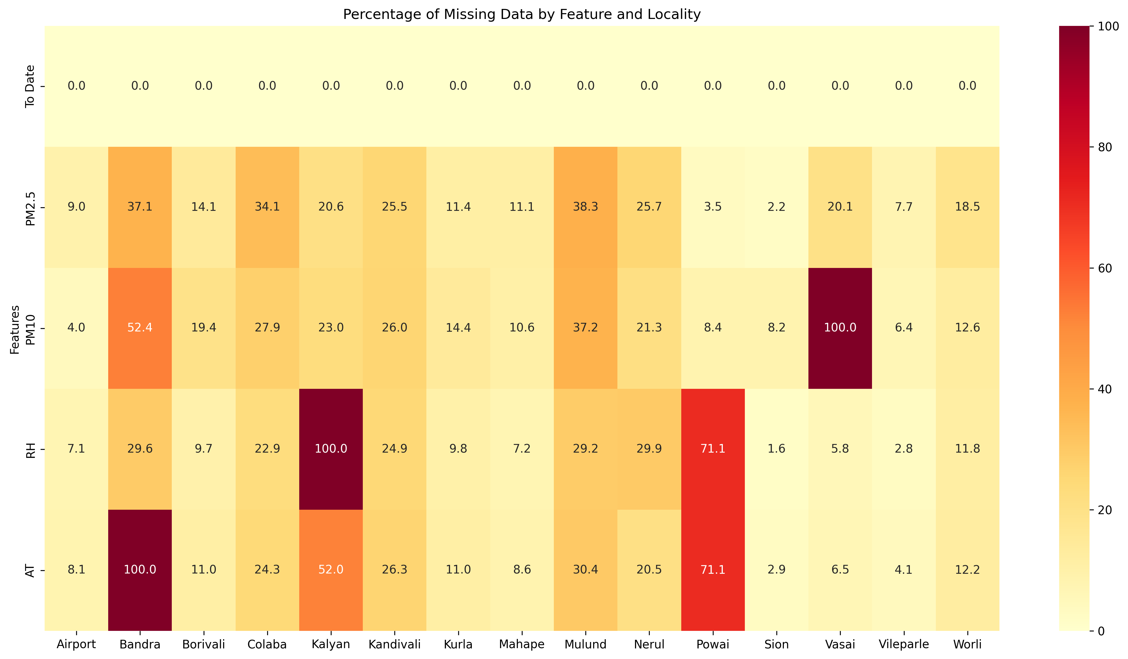
Given the data distribution for each region

Slide 7
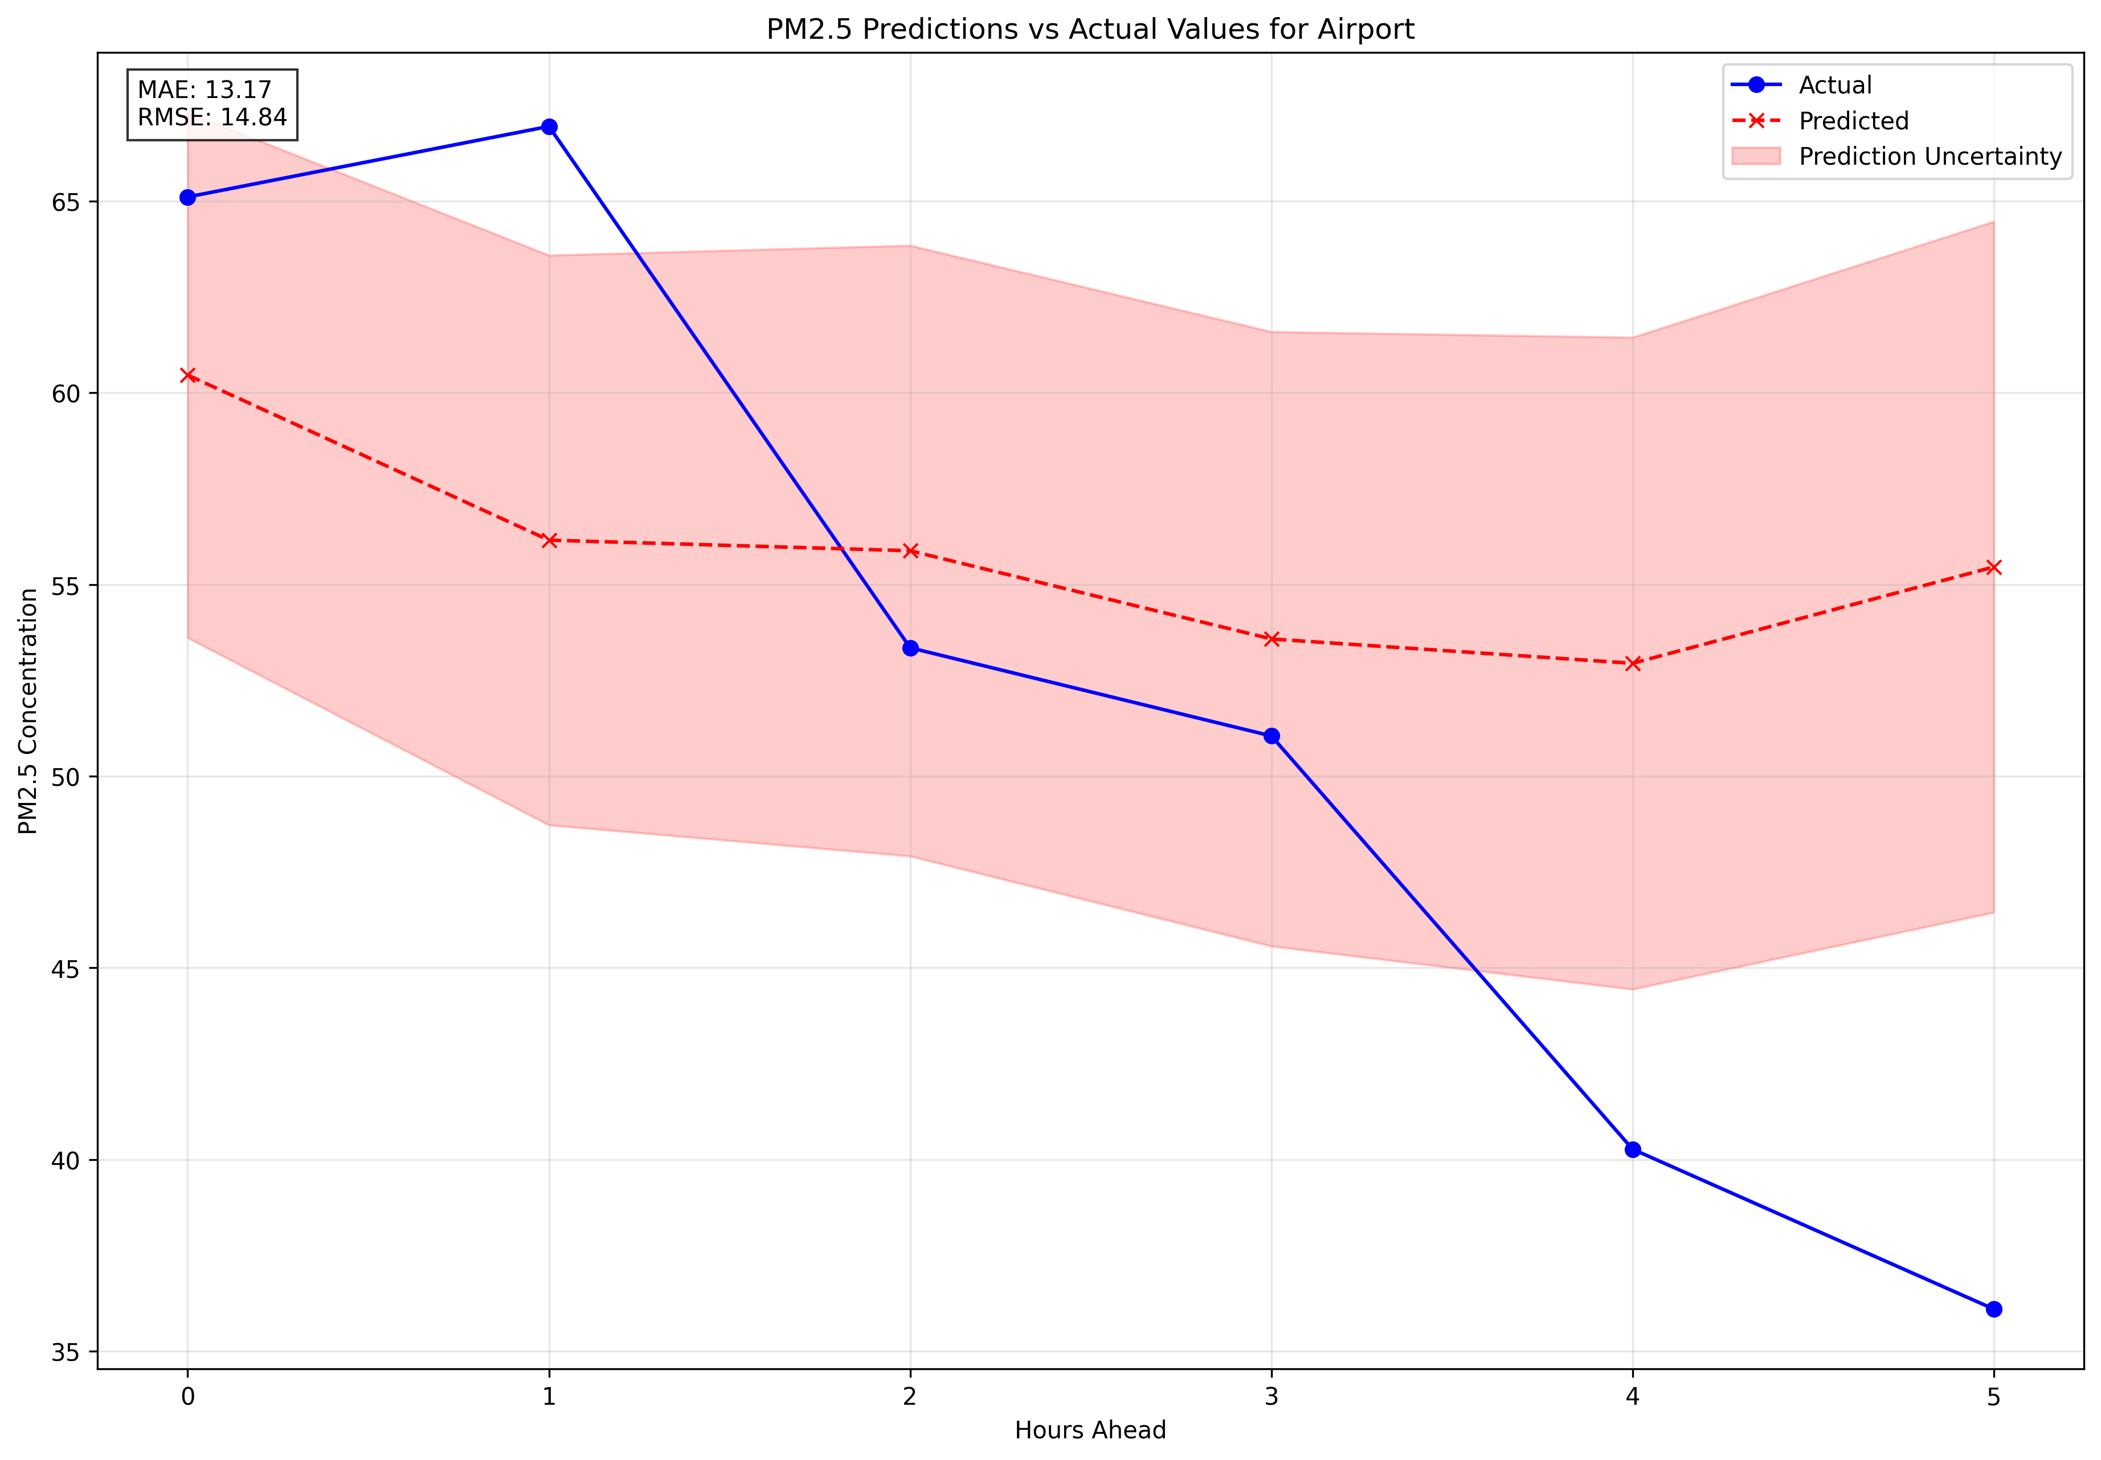
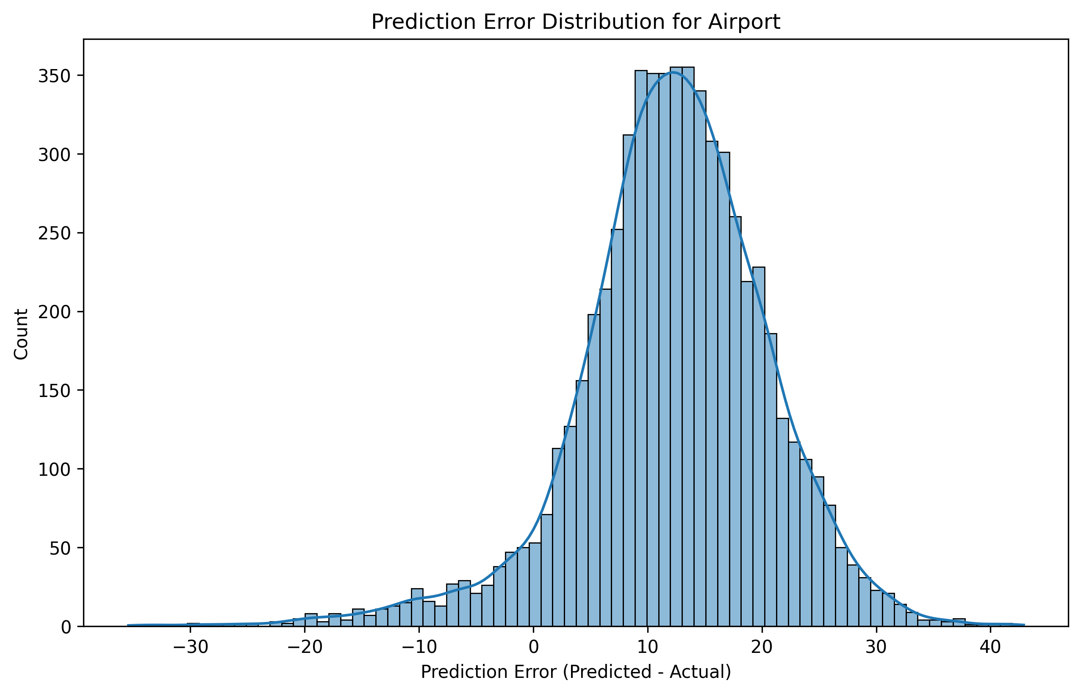
Prediction per region with LSTM
Airport

Slide 8
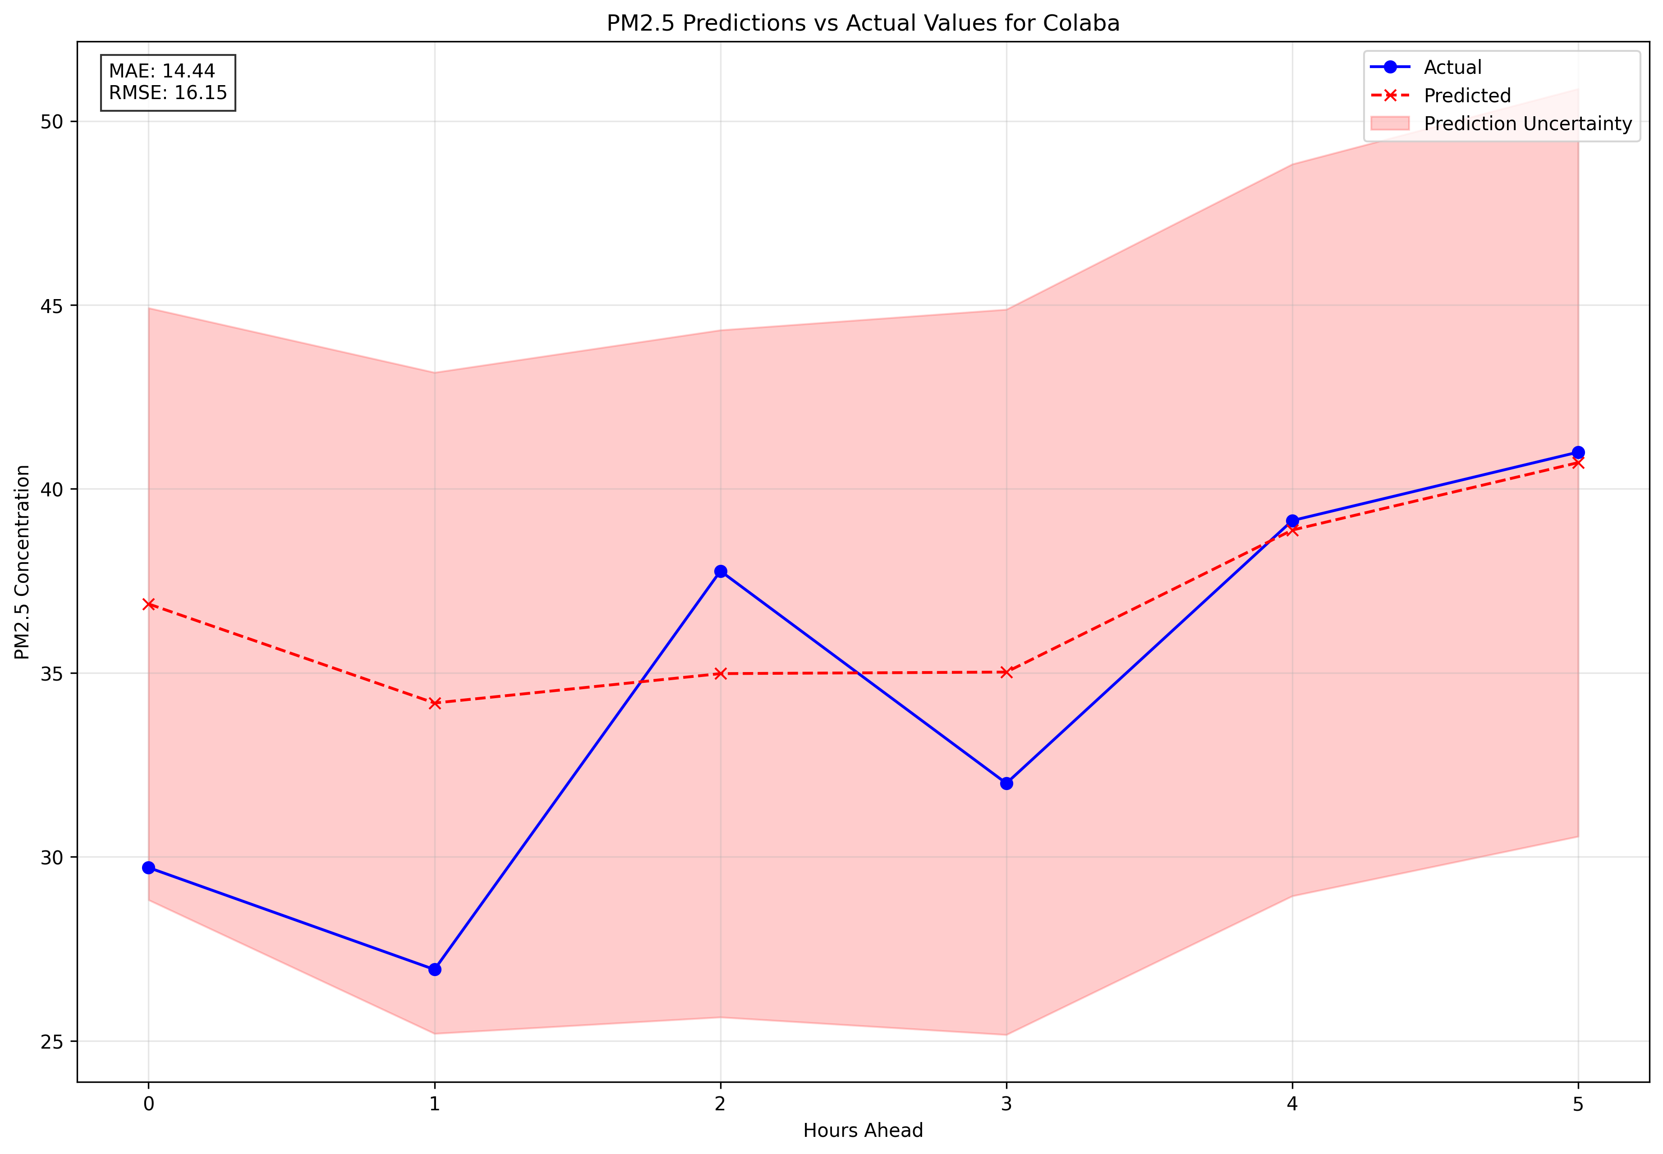
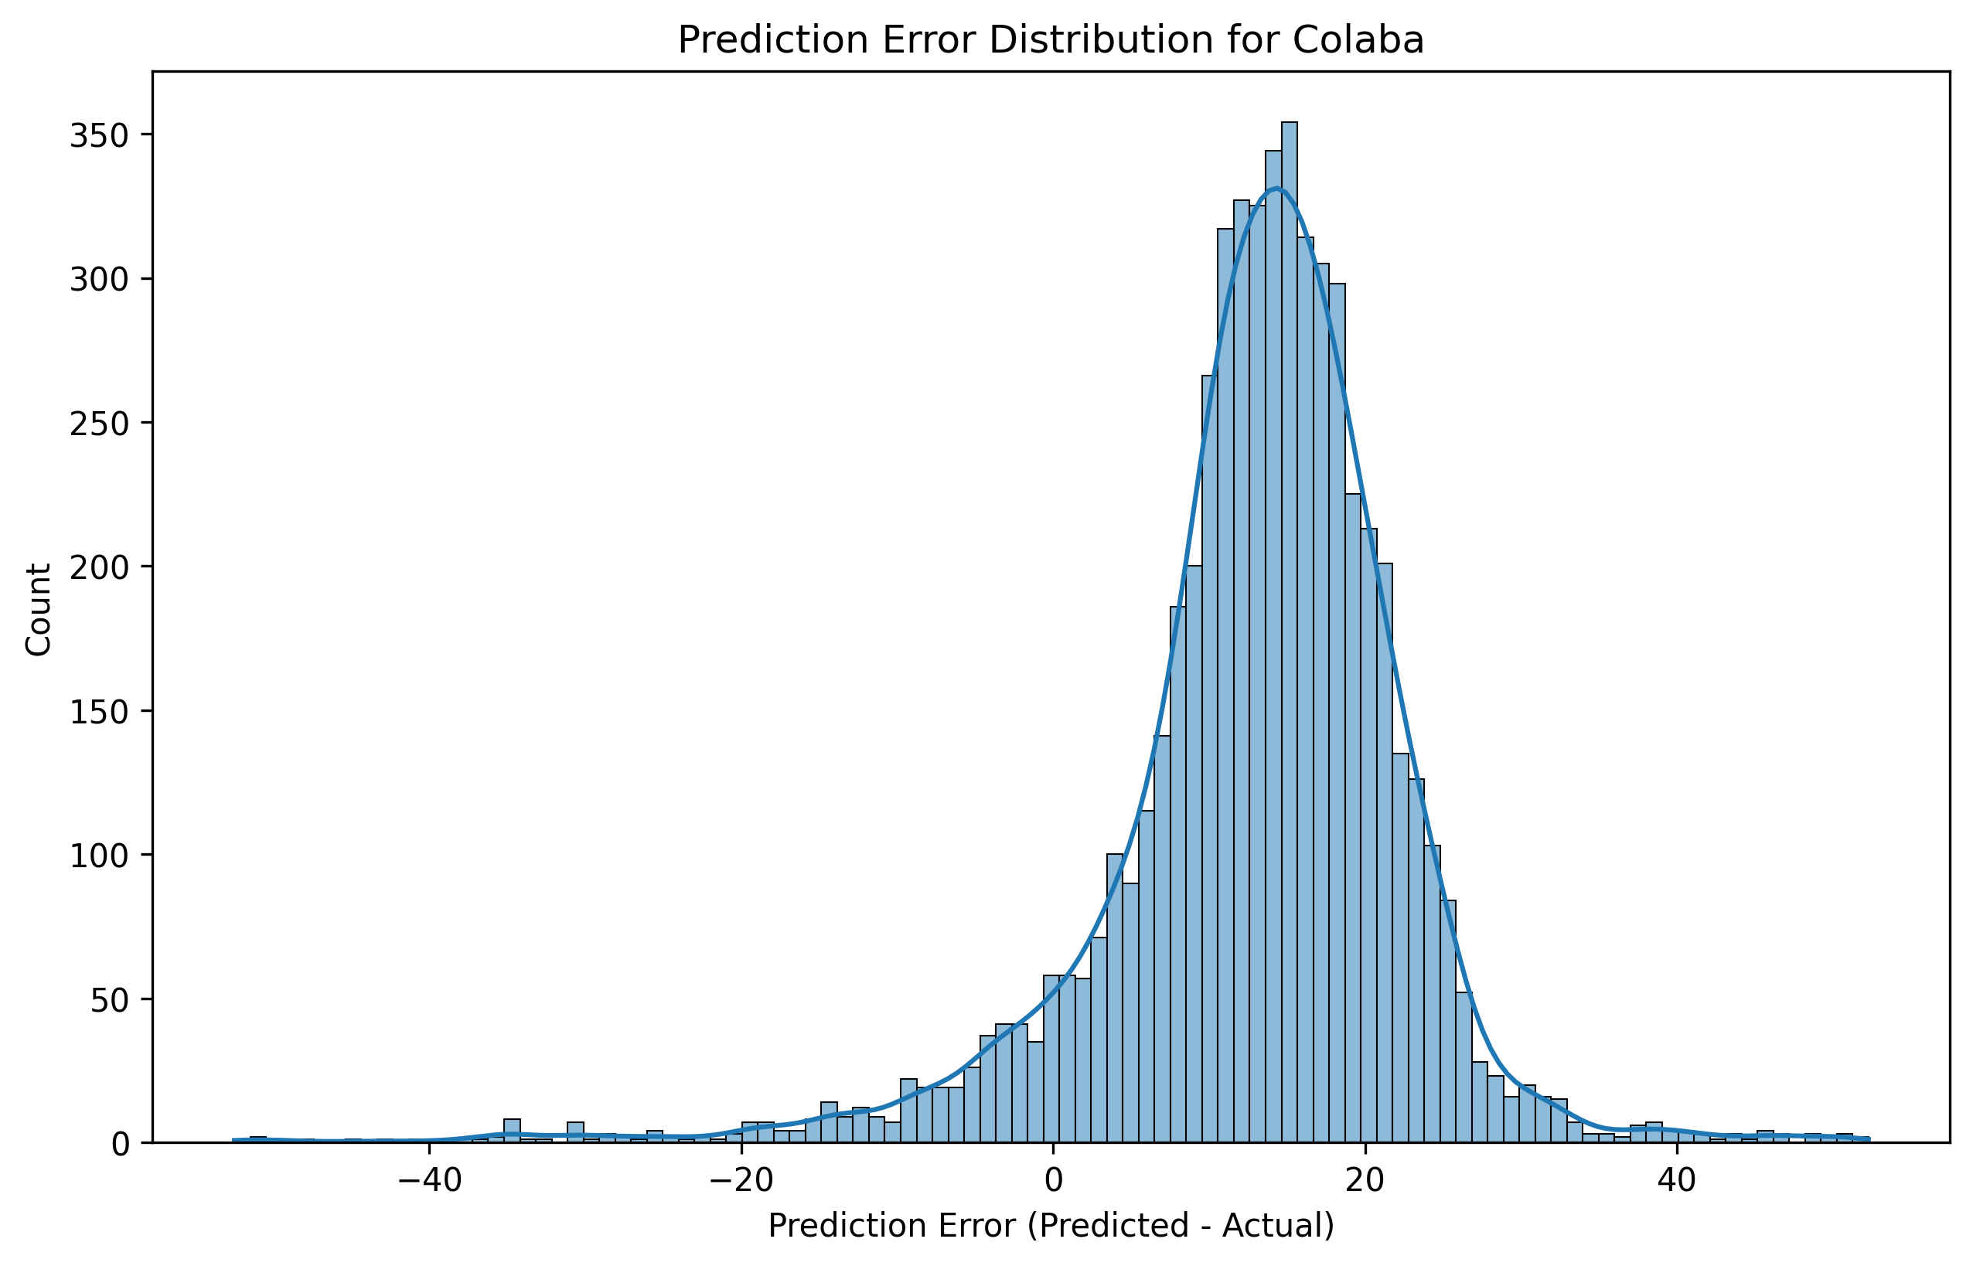
Prediction per region with LSTM
Colaba

Slide 9
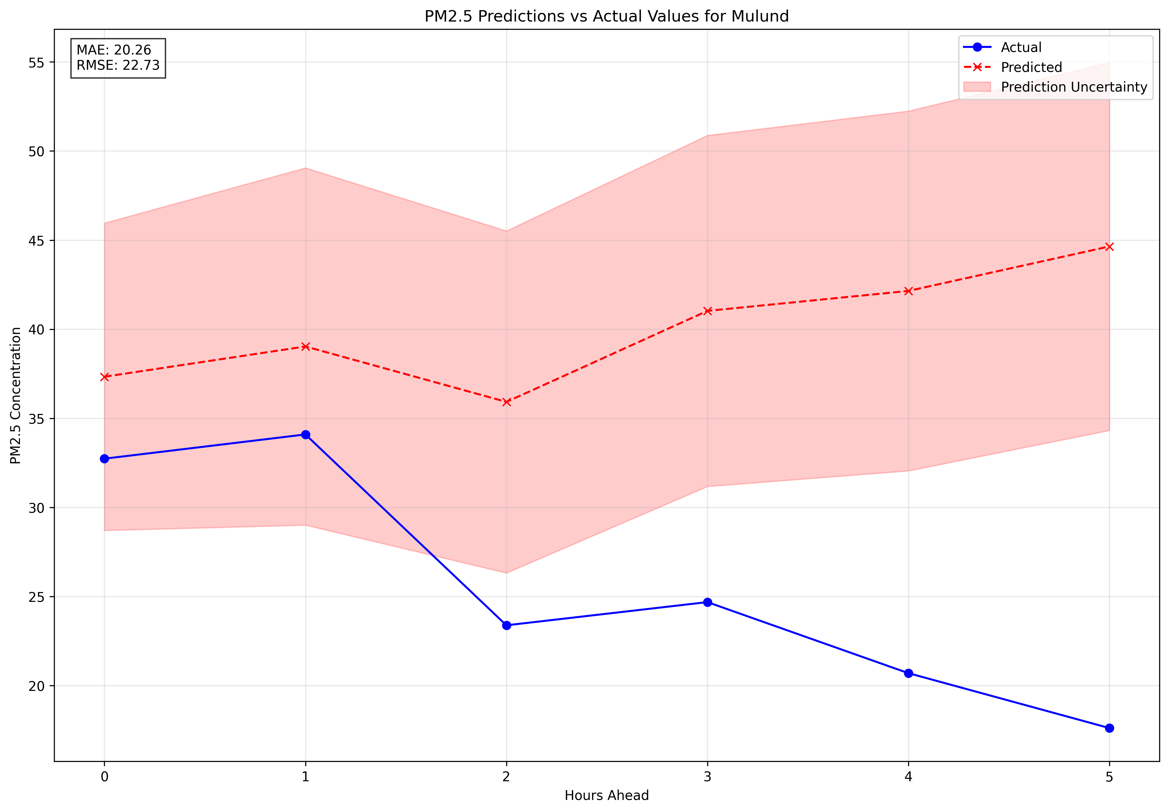
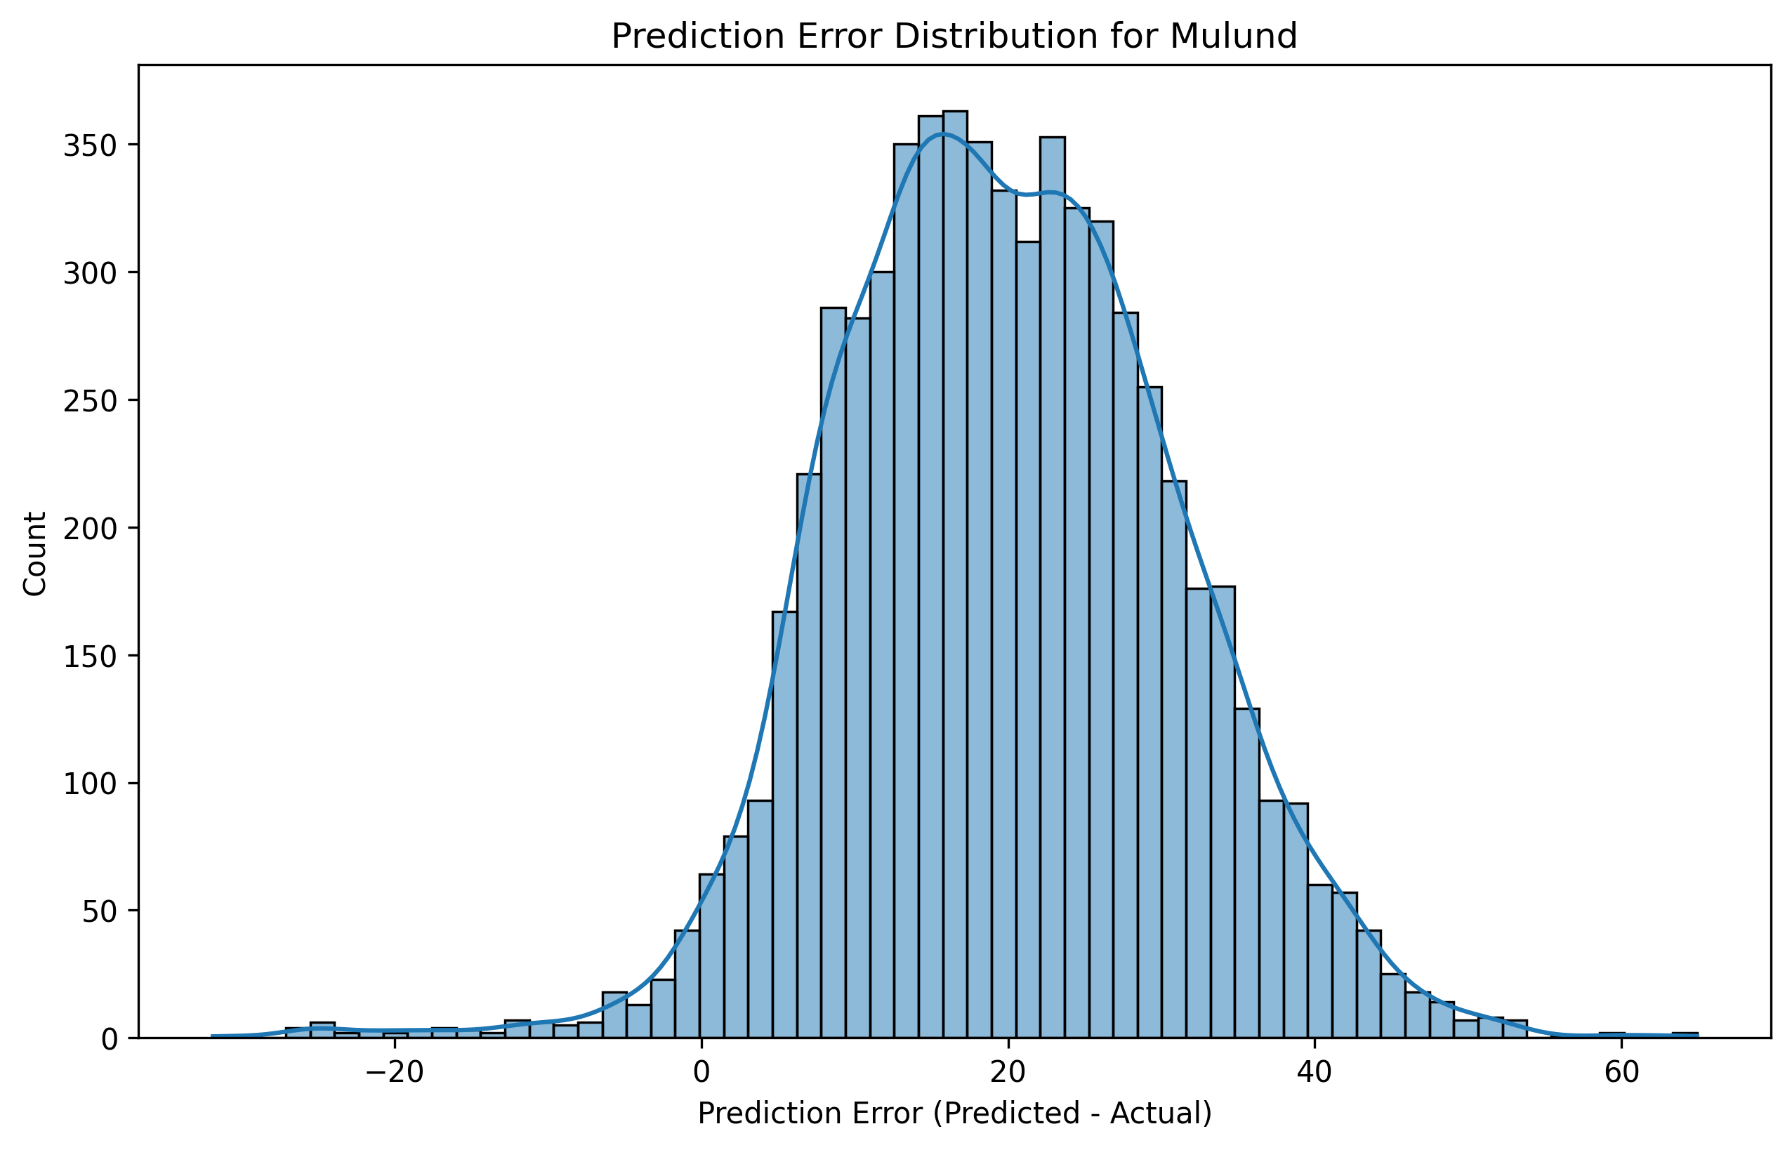
Prediction per region with LSTM
Mulund

Slide 10
MAE and RMSE values
Locality | MAE | RMS
Sion | 21.84 | 22.93
Nerul | 26.59 | 28.47
Powai | 21.64 | 24.45
Airport | 11.72 | 13.23
Powai | 23.24 | 25.92
Locality | MAE | RMS
Kandivali | 21.52 | 24.06
Mahape | 26.19 | 28.98
Kurla | 20.22 | 29.52
Vileparle | 21.84 | 25.66
Worli | 22.18 | 23.34

Slide 11
Result
The average Mae and RMSE were much better with it being around 20 and 23
Also as seen the predictions get random while predicting further away in the future
Going forward I will experiment with current training params and also intend to improve the LSTM training params by taking into account the codistance between the localities and trying to incorporate the inputs of each other to take into consideration

